Slide 1
CP2073 - Networking
Lecture 6
CP2073 - Networking

Slide 2
Introduction
Network Segments
NICs
Repeaters
Hubs
Bridges
Switches
Routers and Brouters
Gateways
CP2073 - Networking

Slide 3
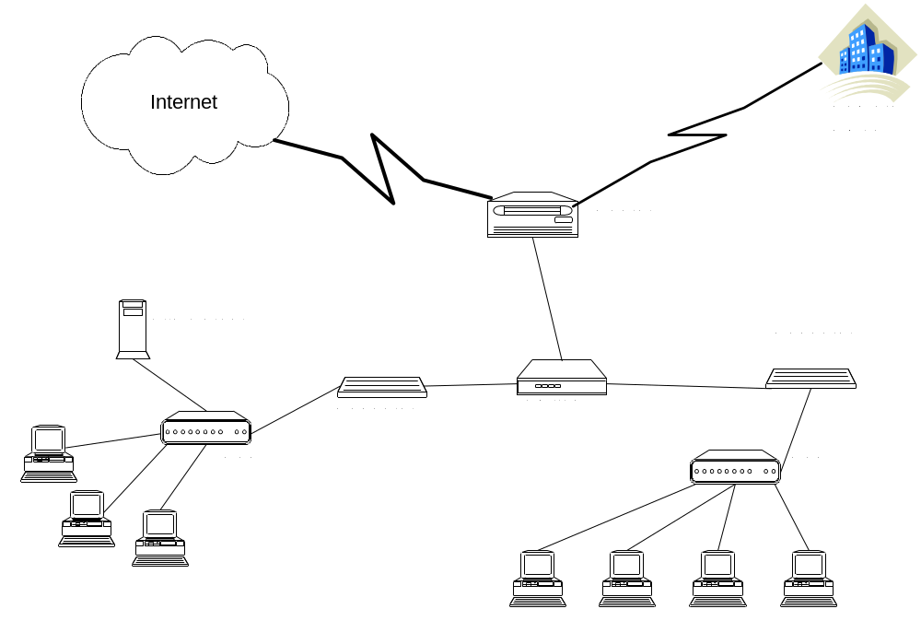
Extending Networks
CP2073 - Networking

Slide 4
Network Segments
No exact definition, usually an area of a LAN, the cable connecting two devices
“The area of the network bound by bridges or switches where collisions are propagated, or the area bound by a router to prevent the propagation of broadcasts”
The more devices which are added to the network the more traffic – solution use a device to ‘filter’ the traffic
Such a device reduces congestion, and improves overall performance
Dividing a network in to segments allows the majority of traffic to stay remain local
CP2073 - Networking

Slide 5
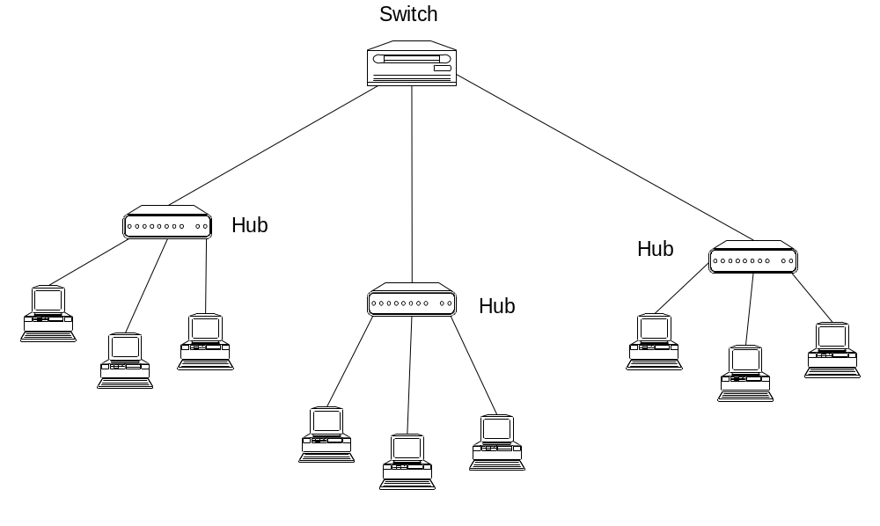
Segment 1
Segment 3
Segment 2
CP2073 - Networking

Slide 6
Broadcast
A broadcast is a signal sent by one device and read by all other devices on the network
Can be used to send a message to all users, may be used by network to find the identity of all the computers on the network
Consumes bandwidth, problem quickly becomes evident as more devices are added to the network
Broadcast Domain – defines the boundary of broadcasts, some devices stop a message passing through (edge of domain), others pass the message on (hubs)
CP2073 - Networking

Slide 7
Collision Domains
Collisions occur when two or more devices transmit at the same time.
This causes the electrical charge of the signal to increase – a collision
All devices in the same collision domain cease transmitting for a random amount of time – to ensure they do not all attempt to start transmitting at the same time again
Network, broadcast and collision domains are no longer the same since the introduction of switches
CP2073 - Networking

Slide 8
Network Interface Card (NIC)
At source:
  Receives the data packet from the Network Layer
  Attaches its the MAC address to the data packet
  Attaches the MAC address of the destination device to the data packet
  Converts data in to packets suitable for the particular network (Ethernet, Token Ring, FDDI)
  Converts packets in to electrical, light or radio signals
  Provides the physical connection to the media
CP2073 - Networking

Slide 9
Network Interface Card (NIC) (2)
As a destination device
  Provides the physical connection to the media
  Translates the signal in to data
  Reads the MAC address to see if it matches its own address
  If it does match, passes the data to the Network Layer
CP2073 - Networking

Slide 10
Repeater
Allows the connection of segments
Extends the network beyond the maximum length of a single segment
Functions at the Physical Layer of the OSI model
A multi-port repeater is known as a Hub
Connects segments of the same network, even if they use different media
Has three basic functions
  Receives a signal which it cleans up
  Re-times the signal to avoid collisions
  Transmits the signal on to the next segment
CP2073 - Networking

Slide 11
Hub
A central point of a star topology
Allows the multiple connection of devices
Can be more than a basic Hub – providing additional services (Managed Hubs, Switched Hubs, Intelligent Hubs)
In reality a Hub is a Repeater with multiple ports
Functions in a similar manner to a Repeater
CP2073 - Networking

Slide 12
Hub (2)
Works at the Physical Layer of the OSI model
Passes data no matter which device it is addressed to
This feature adds to congestion
Use large Hubs (24 port), or stacking them exacerbates this negative feature
CP2073 - Networking

Slide 13
Hub Features
Type of media connection needed
Number of ports
Speed
Managed or Unmanaged
Requirement for Uplink Port ? (allows two Hubs to be connected using a patch cable – crossover cable)
Token Ring Hubs are known as MAUs – see last week’s notes
CP2073 - Networking

Slide 14
Bridge
Like a Repeater or Hub it connects segments
Works at Data Layer – not Physical
Uses Mac address to make decisions
Acts as a ’filter’, by determining whether or not to forward a packet on to another segment
CP2073 - Networking

Slide 15
Bridge (2)
Builds a Bridging Table, keeps track of devices on each segment
Filters packets, does not forward them, by examining their MAC address
It forwards packets whose destination address is on a different segment from its own
It divides a network in to multiple collision domains – so reducing the number of collisions
CP2073 - Networking

Slide 16
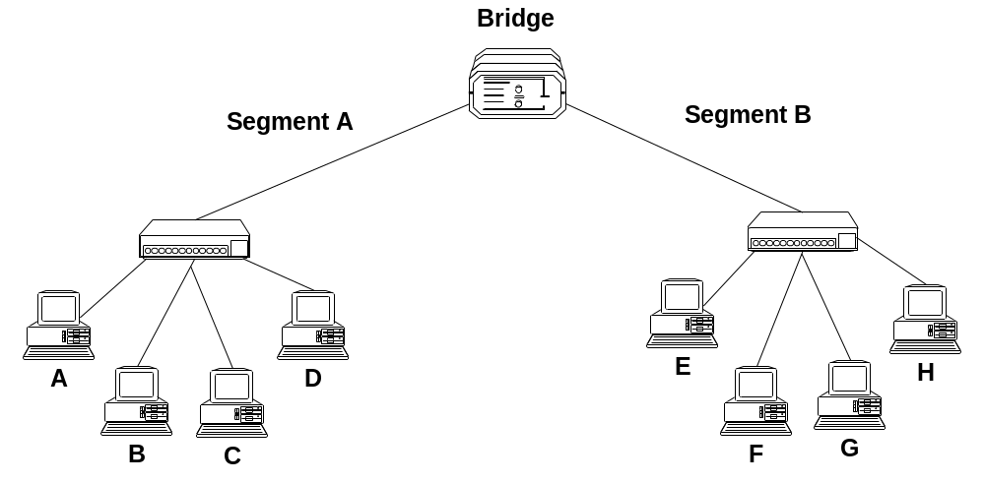
Bridge (3)
Uses the Spanning Tree Protocol (STP) – to decide whether to pass a packet on to a different network segment
A Transmits to C, bridge will not pass it to Segment B
G Transmits to B, bridge will pass it to Segment A
CP2073 - Networking

Slide 17
Switch
A multiport Bridge, functioning at the Data Link Layer
Each port of the bridge decides whether to forward data packets to the attached network
Keeps track of the Mac addresses of all attached devices (just like a bridge)
Similarly priced to Hubs – making them popular
Acts like a Hub, but filters like a Bridge
Each port on a Switch is a collision domain
CP2073 - Networking

Slide 18
Brouter
Functions both as Bridge and a Router – hence name
Can work on networks using different protocols
Can be programmed only to pass data packets using a specific protocol forward to a segment – in this case it is functioning in a similar manner to a Bridge
If a Brouter is set to route data packets to the appropriate network with a routed protocol such as IP, it is functioning as a Router
CP2073 - Networking

Slide 19
Router
Works at Network Layer in an intelligent manner
Can connect different network segments, if they are in the same building or even on the opposite side of the globe
Work in LAN, MAN and WAN environments
Allows access to resources by selecting the best path
Can interconnect different networks – Ethernet with Token Ring
Changes packet size and format to match the requirements of the destination network
CP2073 - Networking

Slide 20
Router (2)
Two primary functions – to determine the ‘best path’ and to share details of routes with other routers
Routing Table – a database which keeps track of the routes to networks and the associated costs
Static Routing – routes are manually configured by a network administrator
Dynamic Routing – adjust automatically to changes in network topology, and information it receives from other routers
Routing Protocol – uses a special algorithm to route data across a network eg RIP
CP2073 - Networking

Slide 21
Gateway
Allows different networks to communicate by offering a translation service from one protocol stack to another
They work at all levels of the OSI model – due to the type of translation service they are providing
Address Gateway – connects networks using the same protocol, but using different directory spaces such as Message Handling Service
Protocol Gateway – connects network using different protocols. Translates source protocol so destination can understand it
Application Gateway – translates between applications such as from an Internet email server to a messaging server
CP2073 - Networking

Slide 22
Advantages and Disadvantages
Repeater
Advantages – Can connect different types of media, can extend a network in terms of distance, does not increase network traffic
Disadvantages – Extends the collision domain, can not filter data, can not connect different network architectures, limited number only can be used in network
CP2073 - Networking

Slide 23
Advantages and Disadvantages (2)
Hub
Advantages – Cheap, can connect different media types
Disadvantages – Extends the collision domain, can not filter information, passes packets to all connected segments
CP2073 - Networking

Slide 24
Advantages and Disadvantages (3)
Bridge
Advantages – Limits the collision domain, can extend network distances, uses MAC address to filter traffic, eases congestion, can connect different types of media, some can connect differing architectures
Disadvantages – Broadcast packets can not be filtered, more expensive than a repeater, slower than a repeater – due to additional processing of packets
CP2073 - Networking

Slide 25
Advantages and Disadvantages (4)
Switch
Advantages - Limits the collision domain, can provide bridging, can be configured to limit broadcast domain
Disadvantages – More expensive than a hub or bridge, configuration of additional functions can be very complex
CP2073 - Networking

Slide 26
Advantages and Disadvantages (5)
Router
Advantages – Limits the collision domain, can function in LAN or WAN, connects differing media and architectures, can determine best path/route, can filter broadcasts
Disadvantages – Expensive, must use routable protocols, can be difficult to configure (static routing), slower than a bridge
CP2073 - Networking

Slide 27
Summary
Network Segments
NICs
Repeaters
Hubs
Bridges
Switches
Routers and Brouters
Gateways
Disadvantages/ Advantages
Questions ?
CP2073 - Networking

Slide 28
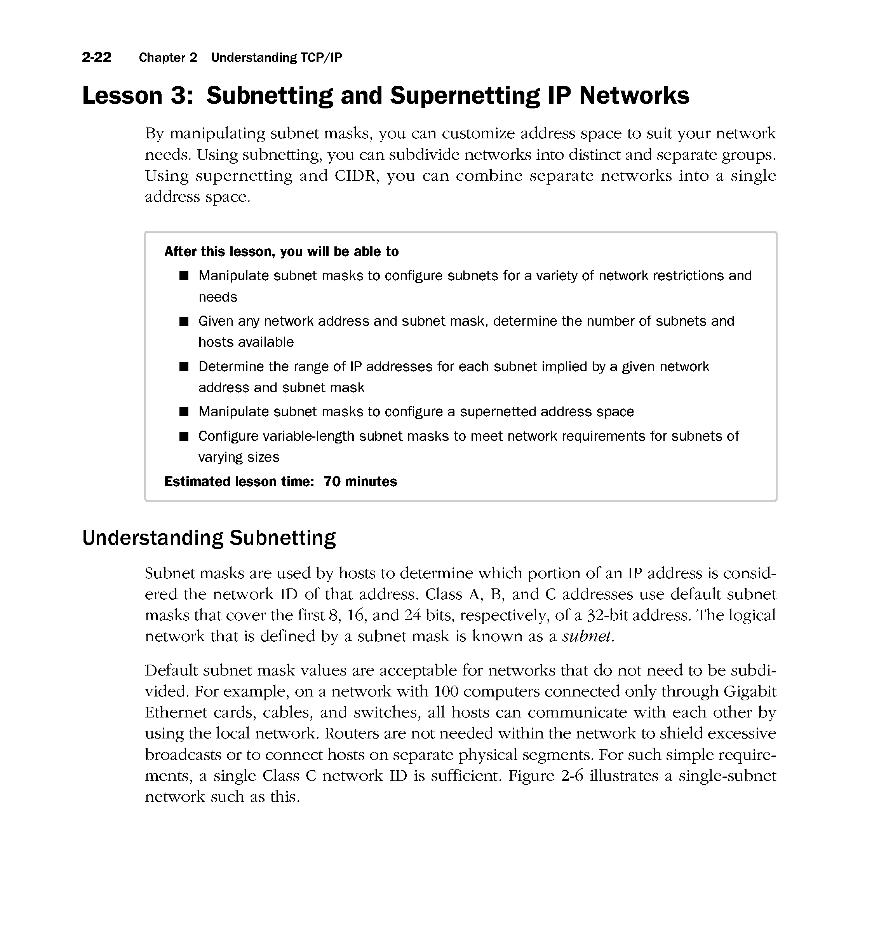
CP2073 - Networking

Slide 29
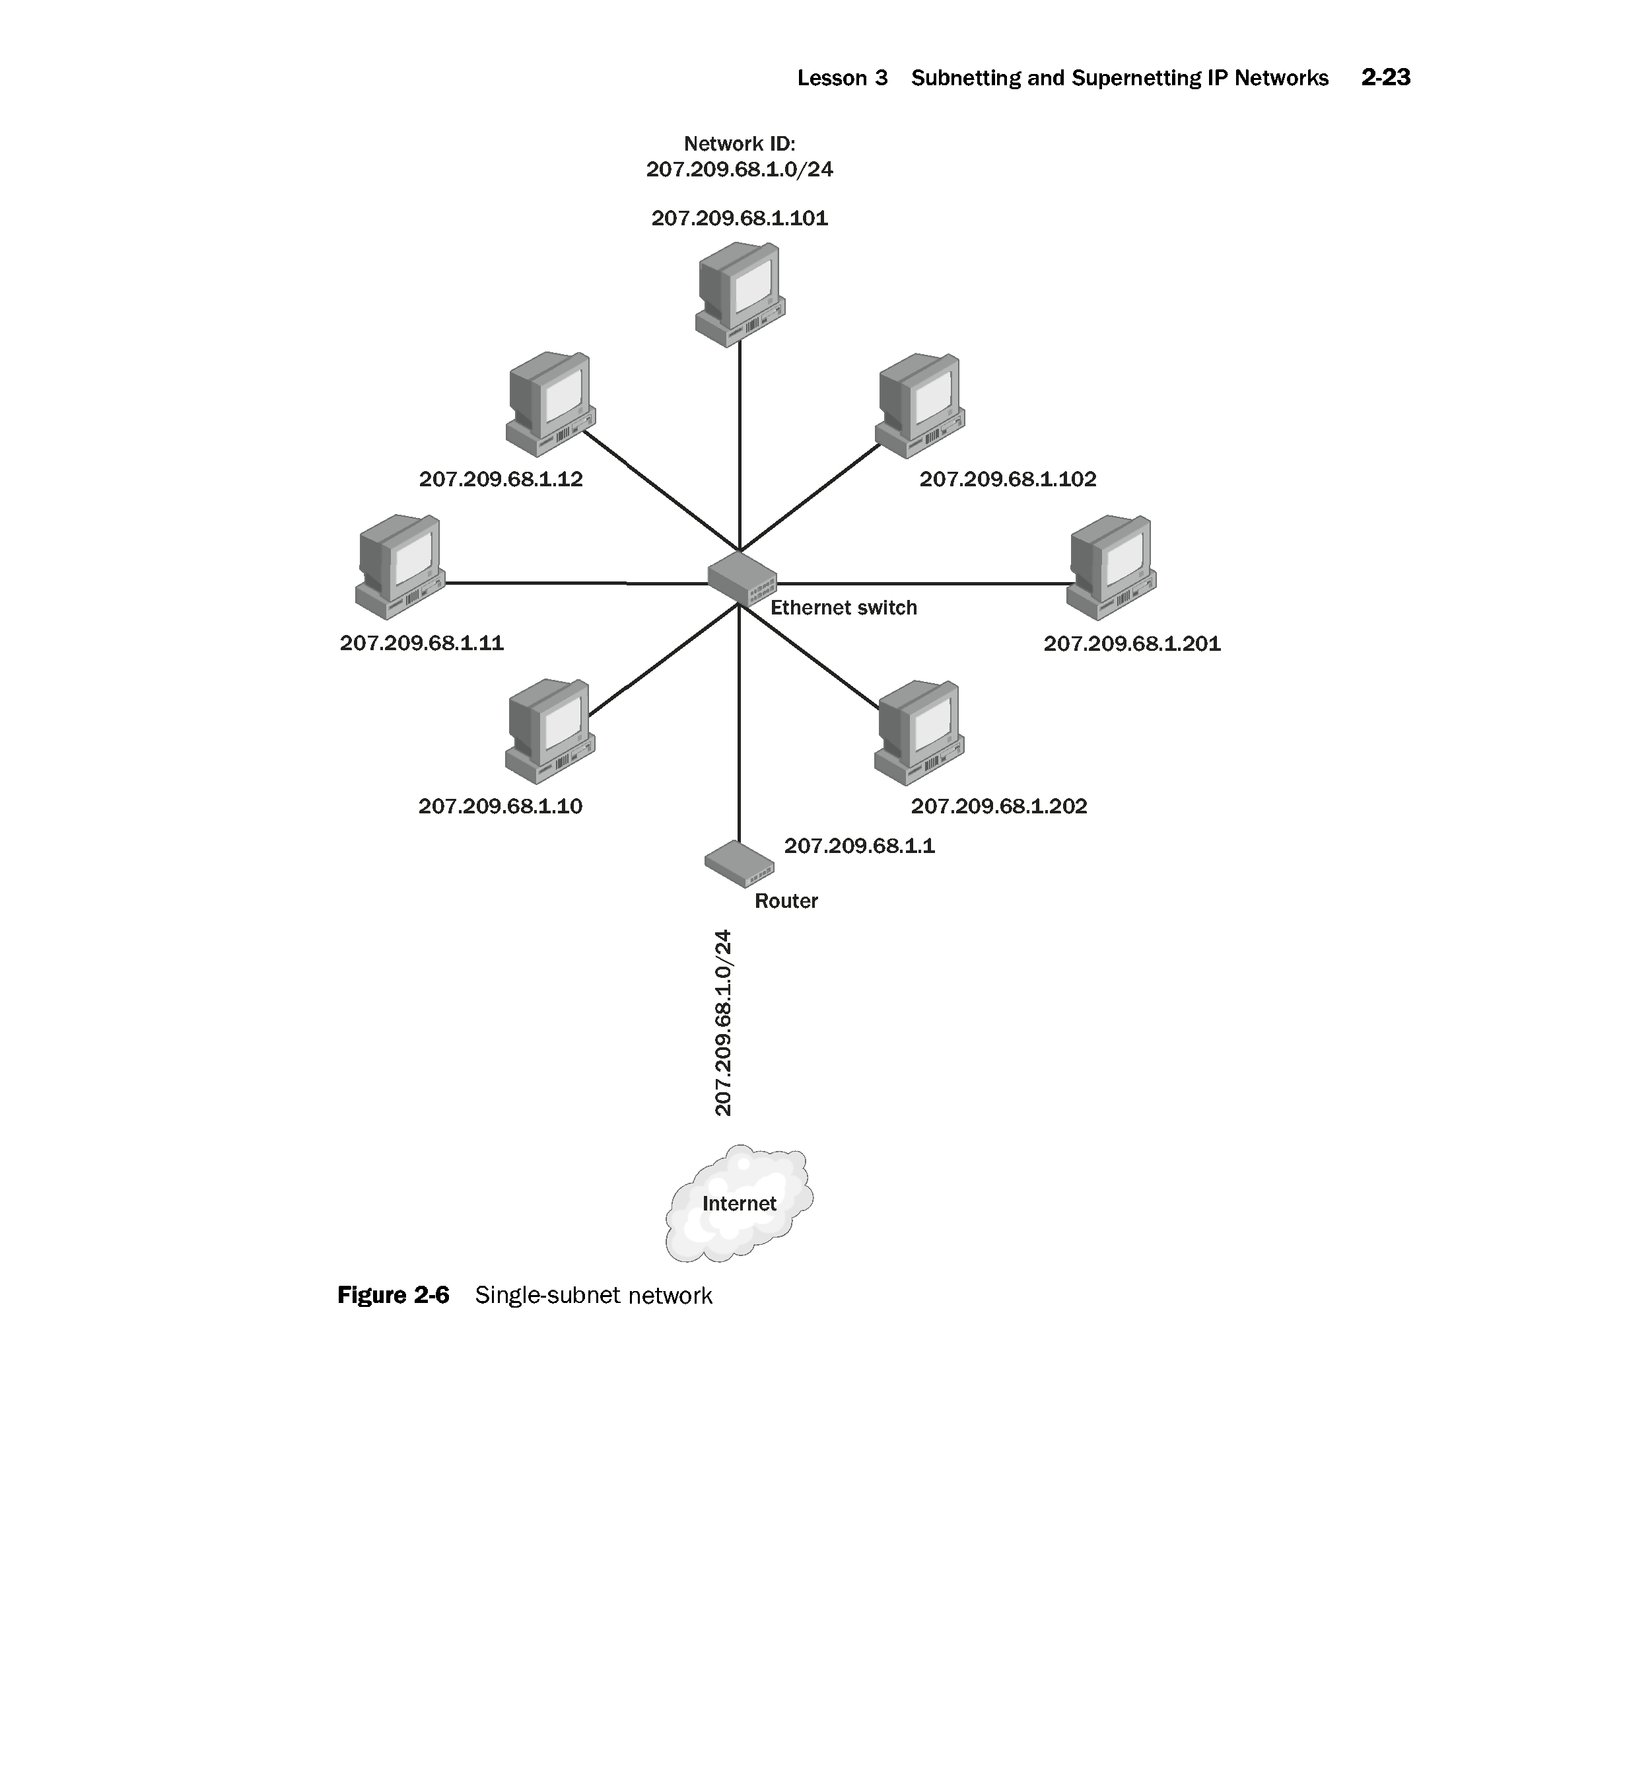
CP2073 - Networking

Slide 30
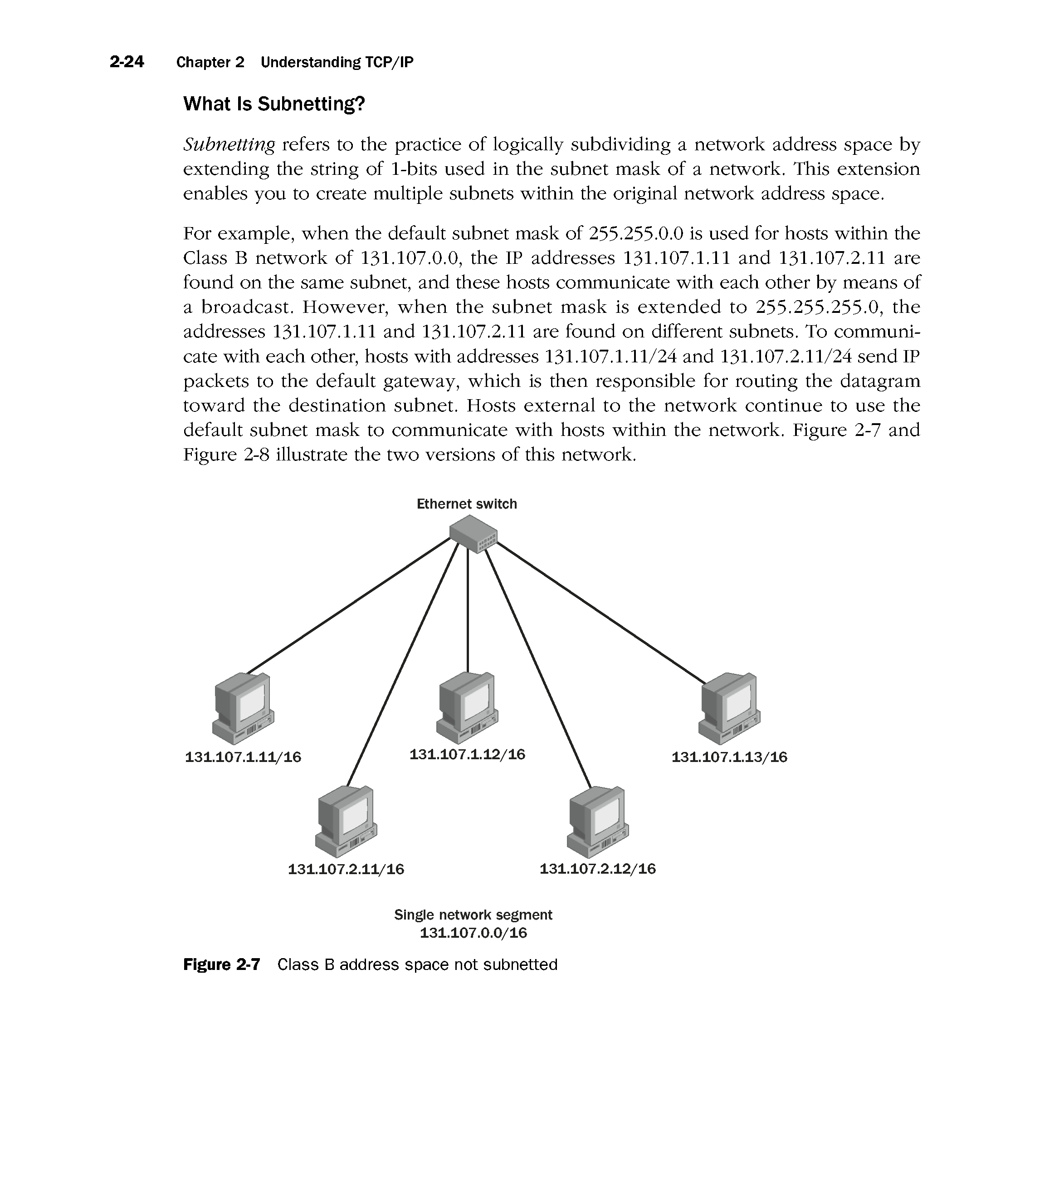
CP2073 - Networking

Slide 31
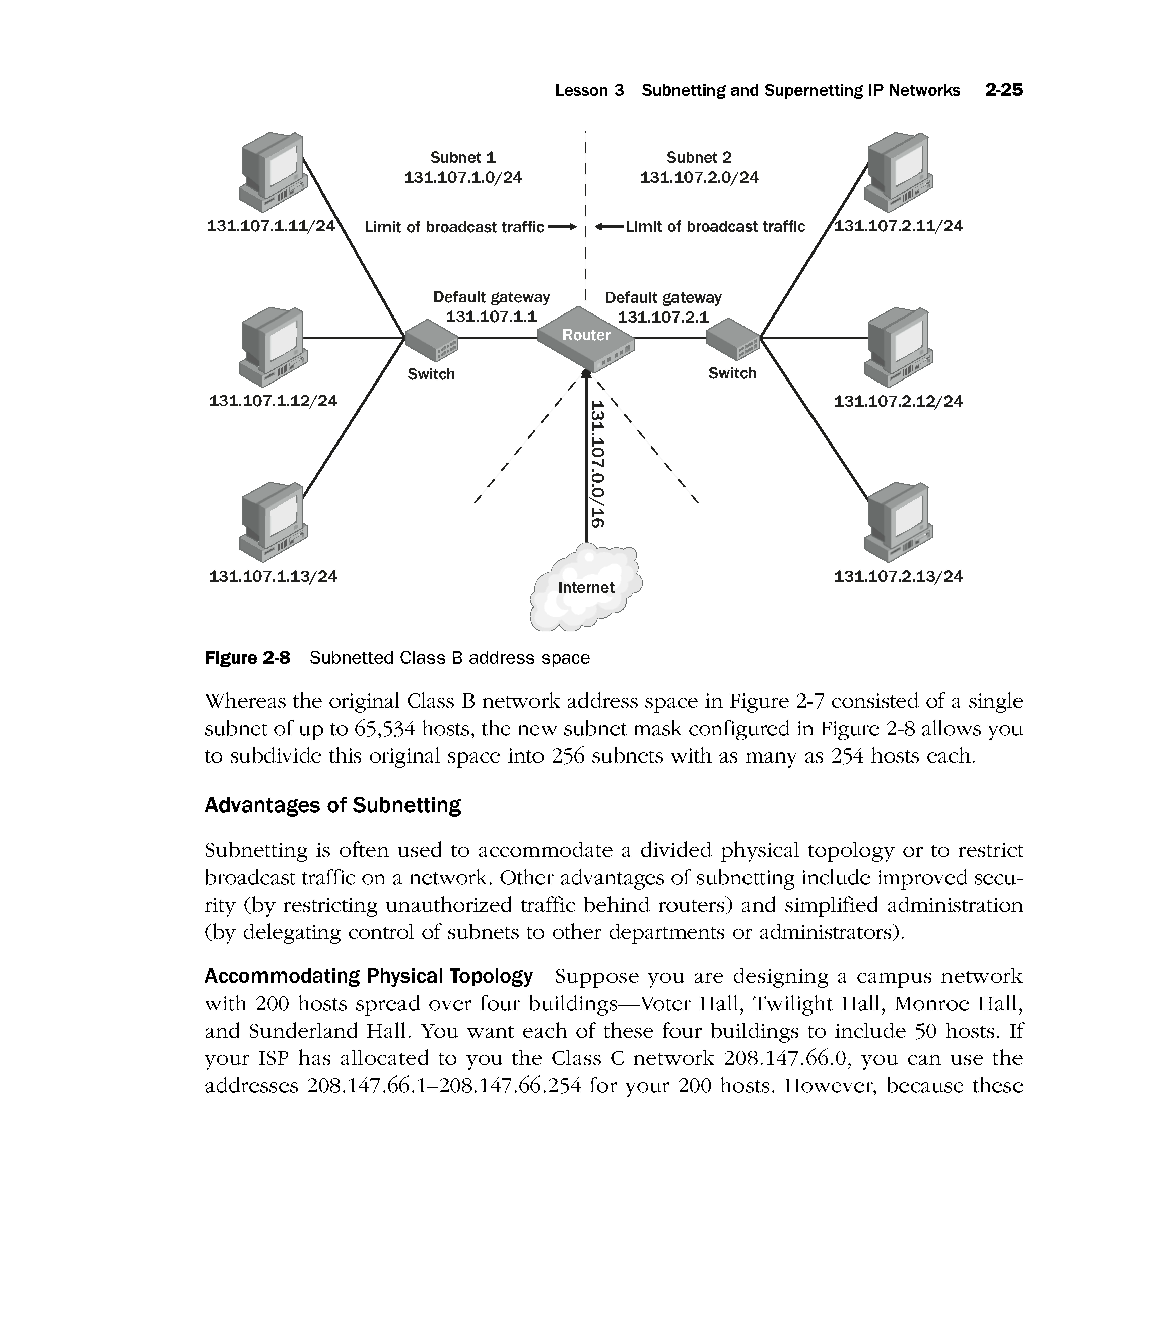
CP2073 - Networking

Slide 32
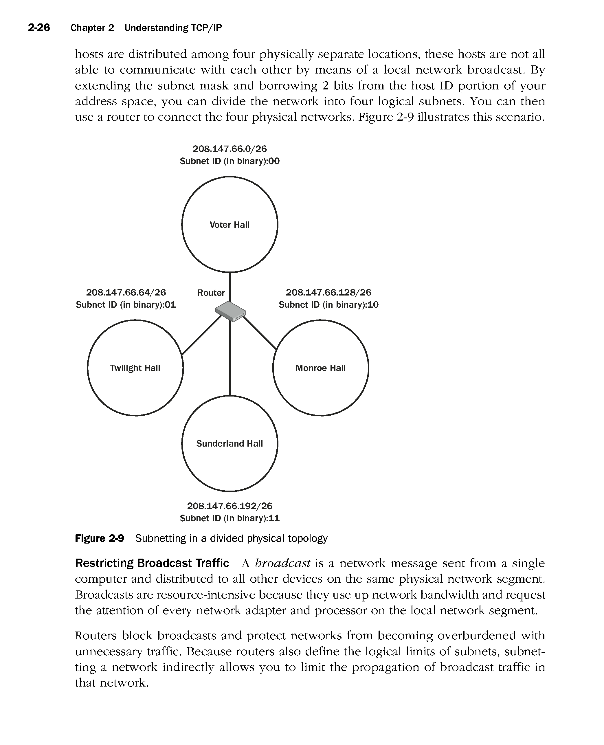
CP2073 - Networking

Slide 33
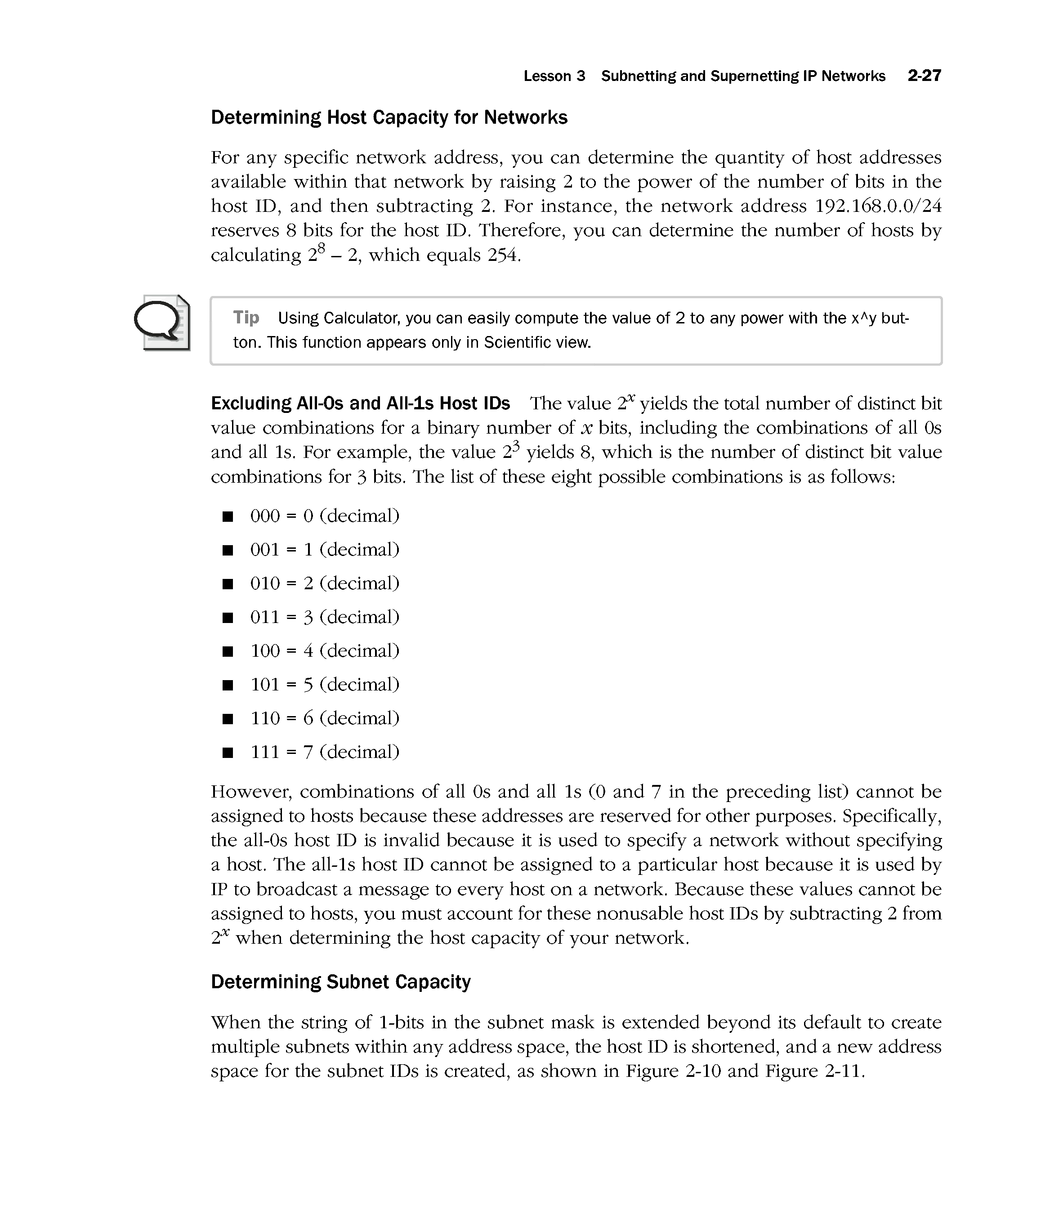
CP2073 - Networking

Slide 34
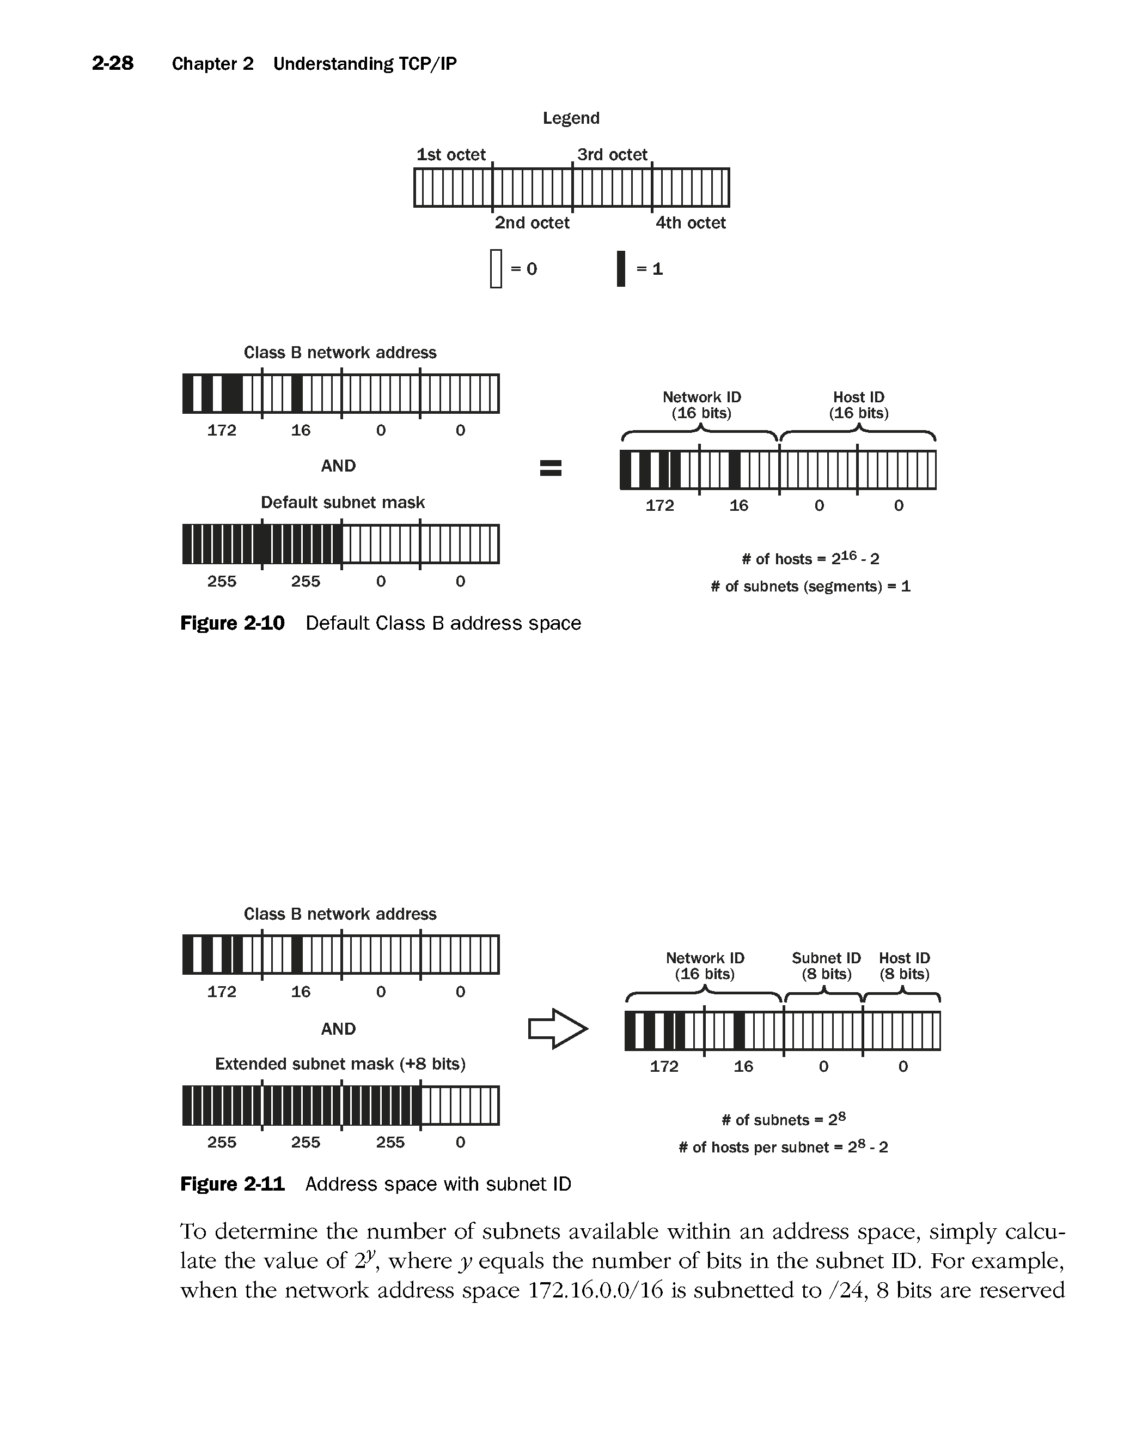
CP2073 - Networking

Slide 35
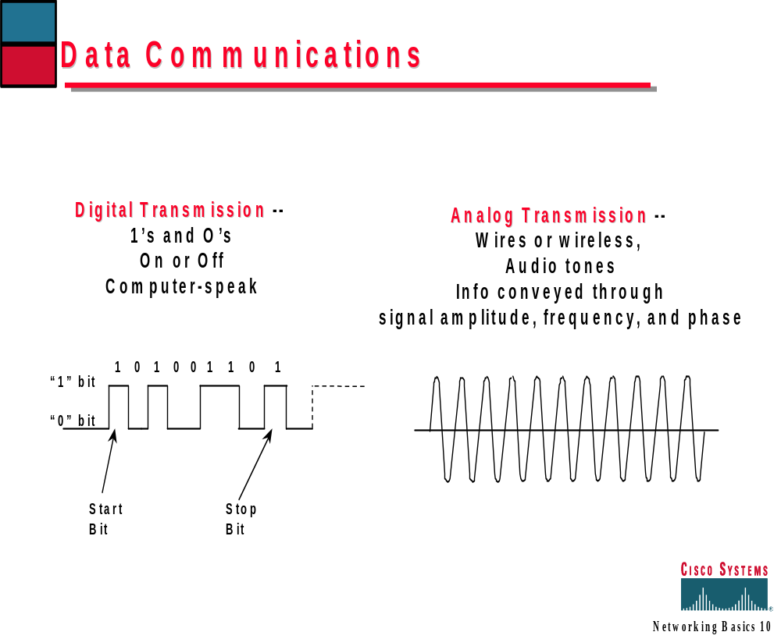
CP2073 - Networking

Slide 36

CP2073 - Networking

Slide 37
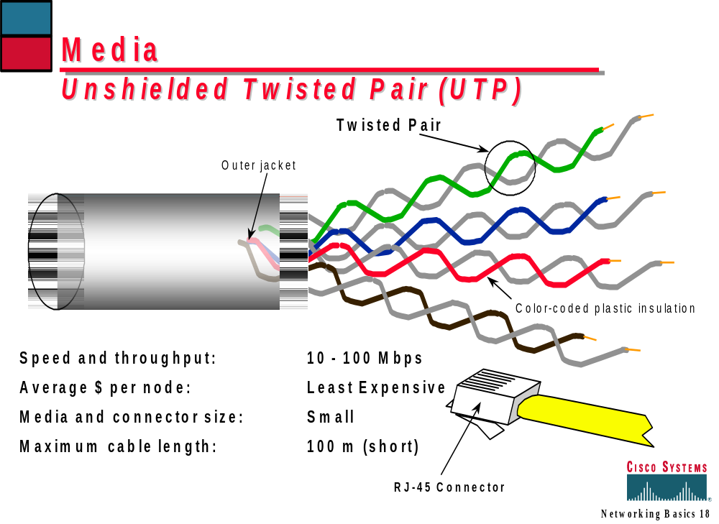
CP2073 - Networking

Slide 38
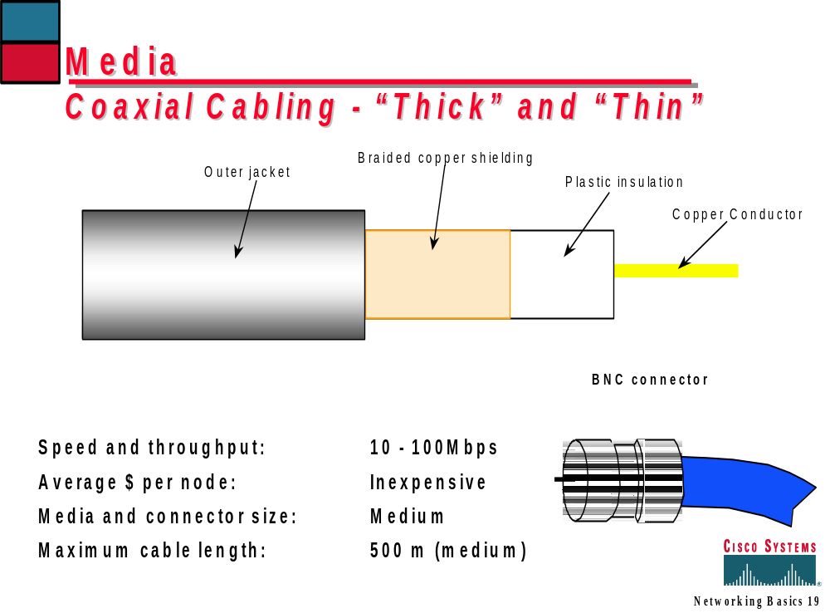
CP2073 - Networking

Slide 39
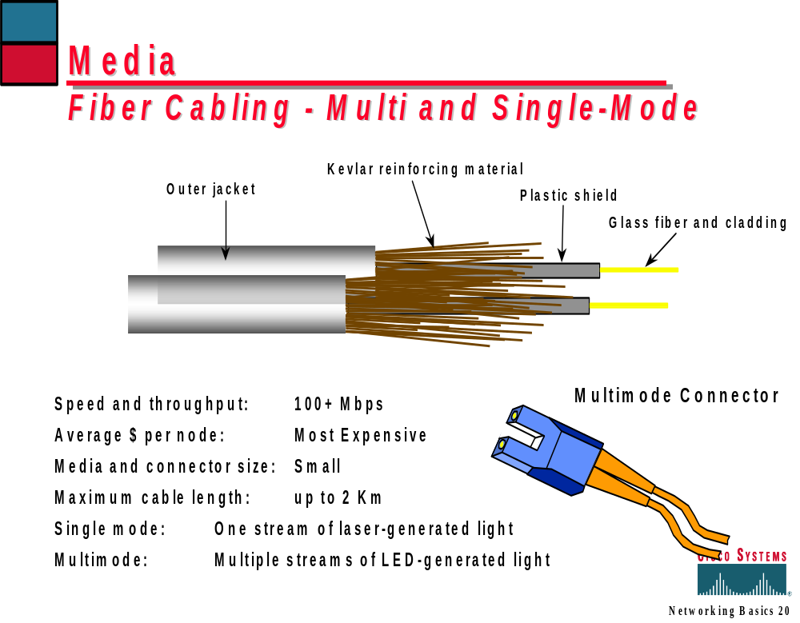
CP2073 - Networking

Slide 40
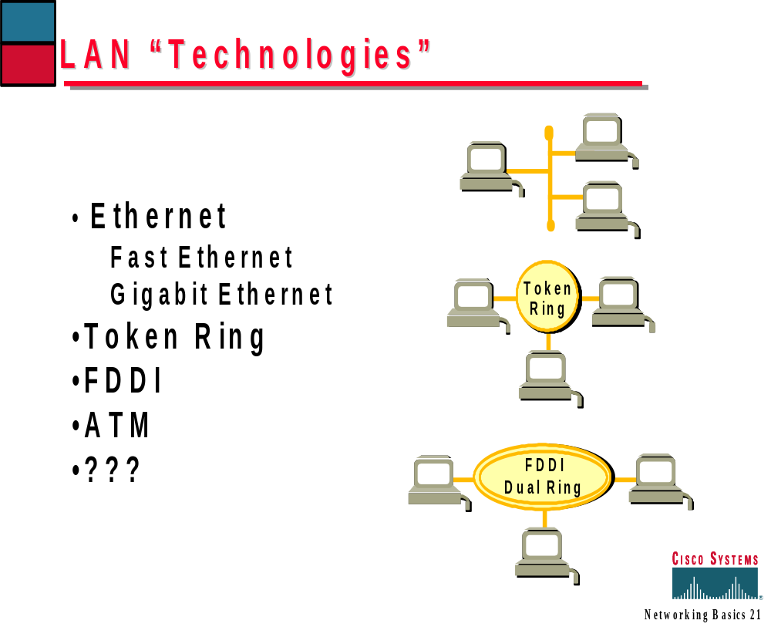
CP2073 - Networking

Slide 41
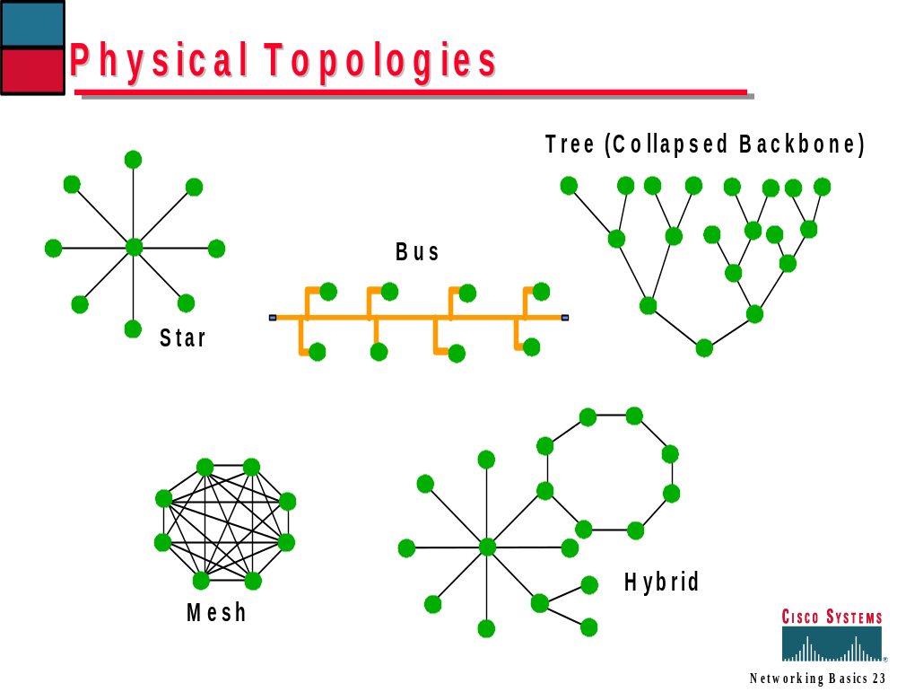
CP2073 - Networking

Slide 42
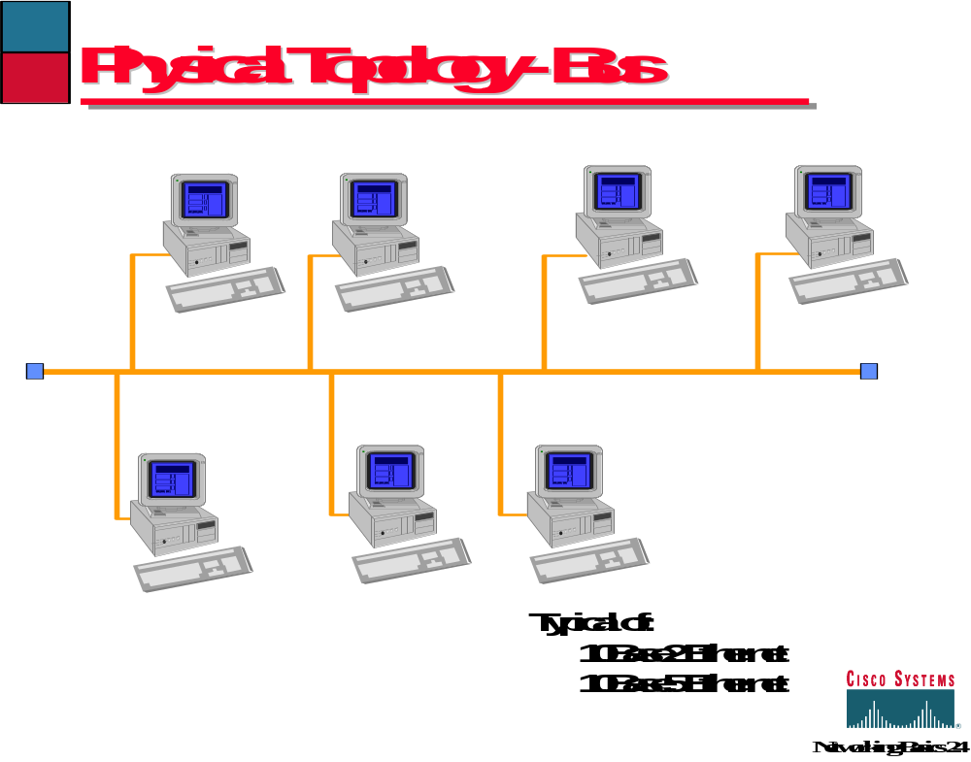
CP2073 - Networking

Slide 43
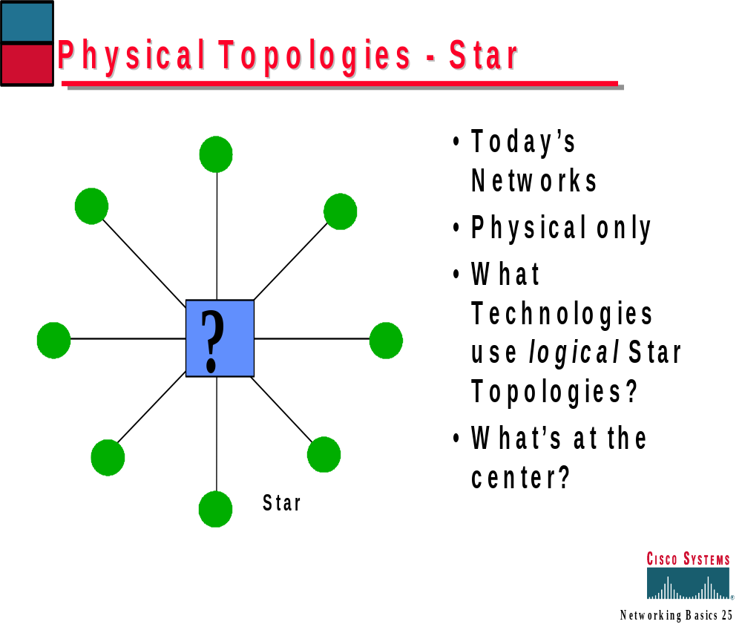
CP2073 - Networking

Slide 44
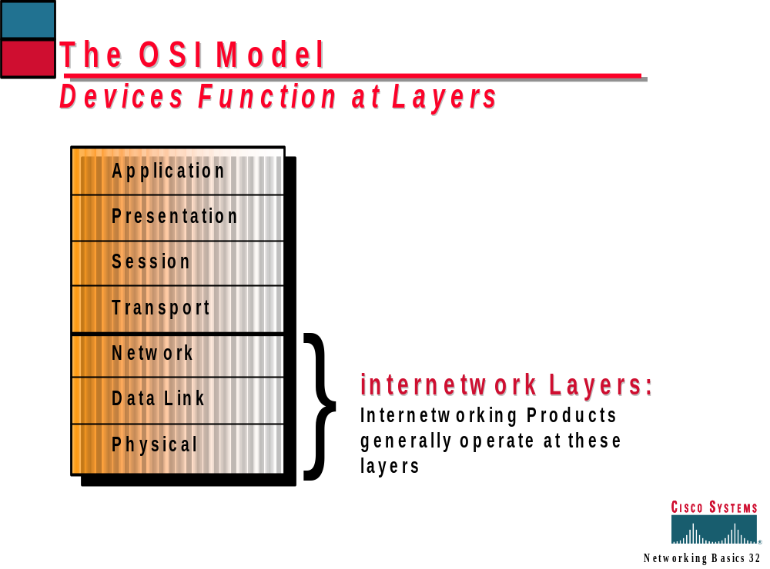
CP2073 - Networking

Slide 45
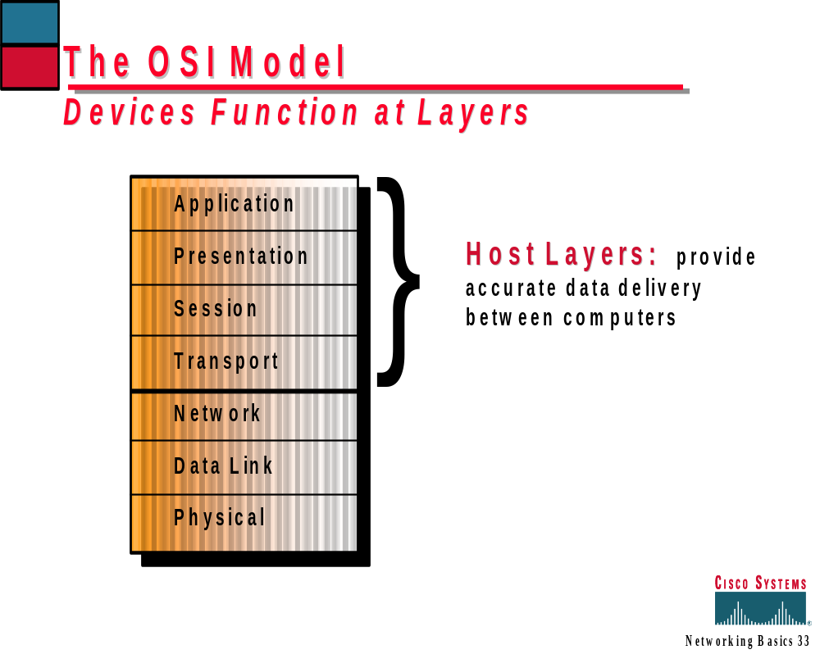
CP2073 - Networking

Slide 46
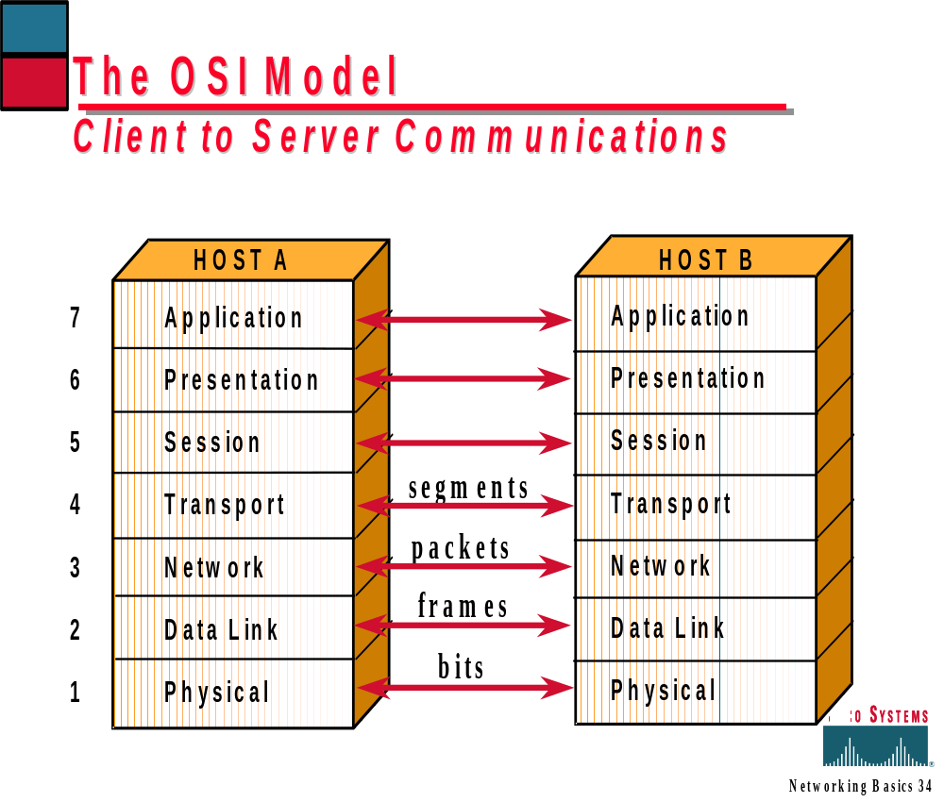
CP2073 - Networking

Slide 47
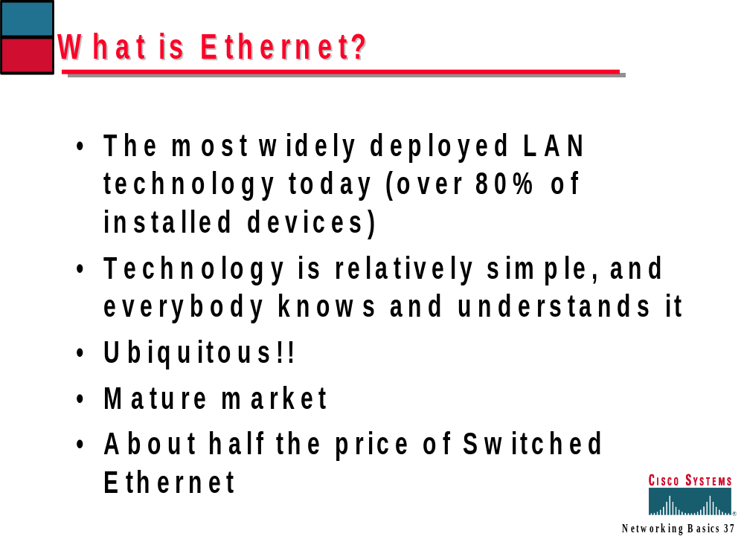
CP2073 - Networking

Slide 48
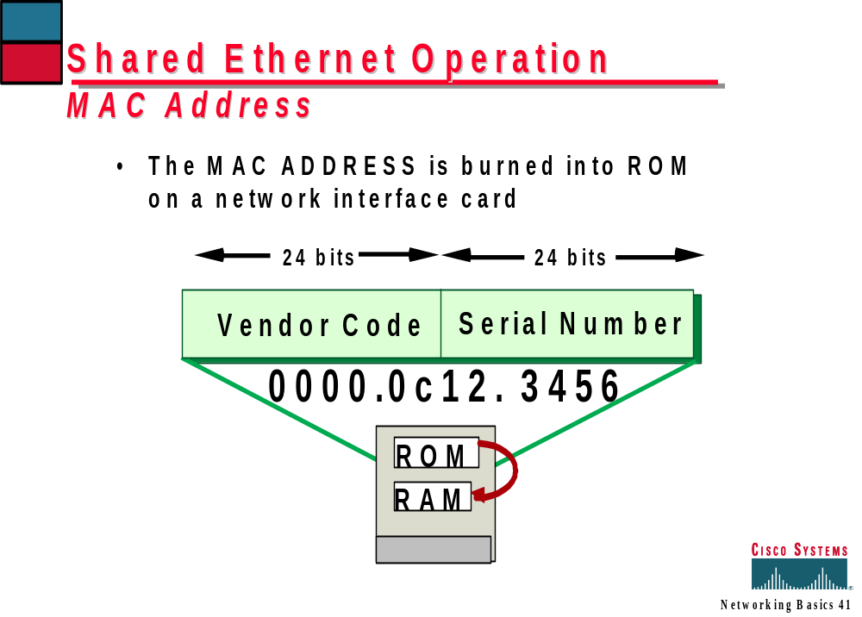
CP2073 - Networking

Slide 49
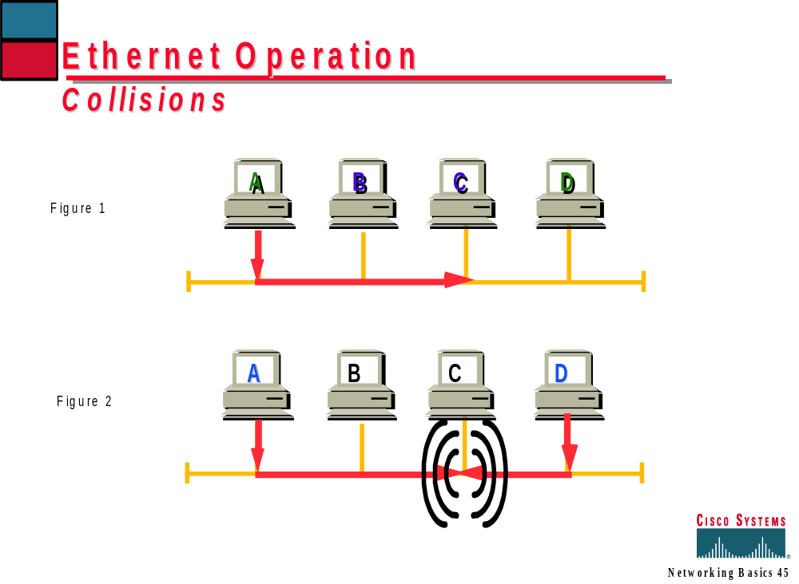
CP2073 - Networking

Slide 50
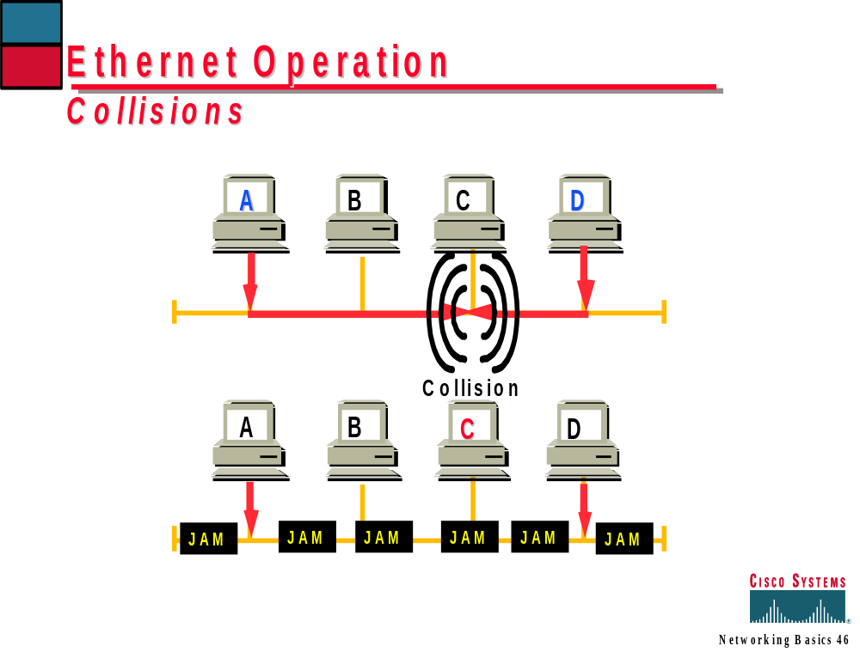
CP2073 - Networking

Slide 51


From E-Mail Message to Bits…...
Data
DATA
Segment
Segment Header
DATA
Packet
Network Header
Segment Header
DATA
Frame
Frame Header
Network Header
Segment Header
DATA
Frame Trailer
Bits
0111111010101100010101101010110001
CP2073 - Networking

Slide 52
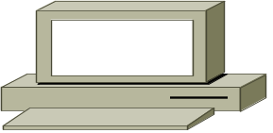

Ethernet Family—IEEE 802.3
Broadcast media
  One person speaks, everybody hears
CSMA/CD
  Carrier sense multiple access with collision detect
Collision domains
Encapsulations
  Ethernet IEEE 802.3
Fast Ethernet and Gigabit Ethernet
CP2073 - Networking

Slide 53
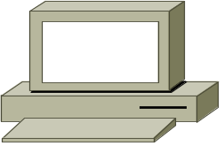

Token Ring—IEEE 802.5
Broadcast media
  One person speaks,
  everybody hears
One Token on the ring
  One person talks at a time
Self managing and healing
  Active monitor
  Upstream/downstream notification
  Beaconing
Fast Token Ring
CP2073 - Networking

Slide 54


Fiber Distributed Data Interface—ANSI X3T9.5
Broadcast media
  One person speaks, everybody hears
One Token on the ring
  One person talks at a time
Self managing and healing
  Dual Ring
  SMT
CP2073 - Networking

Slide 55
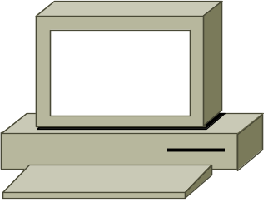

What Is a Broadcast?
Broadcast Frame
Layer 2
Layer 3
fffff…f
255.255.255.255
Network
MAC DA
Protocol DA
“Send Me to
Everyone”
“Send Me to
Everyone on
This Subnet”
CP2073 - Networking

Slide 56
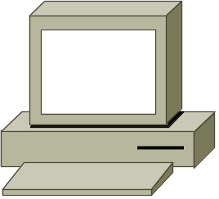

What Is a Multicast?
IP Multicast Frame
Layer 2
Layer 3
0100.5A01.0101
254.1.1.1
Network
MAC DA
Protocol DA
“I’m a Multicast. Send Me to Everyone”
“Send Me to
Everyone in This Class D Group”
CP2073 - Networking

Slide 57



X.25
Non broadcast media
Packet
switched network
  Switched (SVC) or Permanent (PVC) Virtual Connections
Used for wide
area network
3 layer architecture
  Layer 1—X.21 BIS
  Layer 2—LAPB
  Layer 3—GFI, LCI, PTI
CP2073 - Networking

Slide 58

Asynchronous Transfer Mode
Non broadcast media
  Point to point connections or,
  Point to multipoint connections
Traffic split into 53 byte cells, 5 header, 48 payload
For multiprotocol support must run lane or MPOA
Error correction left up to
end devices
CP2073 - Networking

Slide 59
Frame Relay
Non broadcast media
  Point to point connections or,
  Point to multipoint connections
Used for wide area network
Congestion avoidance
  FECN/BECN
Committed Information Rate (CIR)
CP2073 - Networking

Slide 60
ISDN: Technology for Remote Networking
• Ideal for dial-up applications
• Fast connection setup for LAN access
• Cost-effective WAN solution
Capable of effective compression to increase throughput
• Higher speed and digital reliability
• Growing base of customers with ISDN access
• Deployment of standardized ISDN protocols
CP2073 - Networking

Slide 61
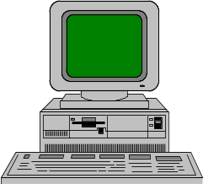
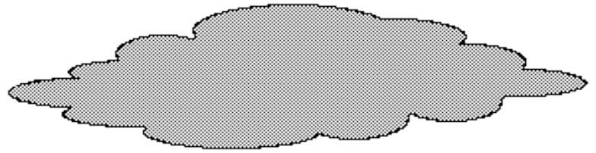
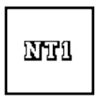




ISDN Basics
Definition:
ISDN is a network architecture in which the network conveys all information, voice and/or non-voice as a digital bit stream directly to the customer’s premisis.
CP2073 - Networking

Slide 62
ISDN Basics
Architecture:
“B” channels carry data only
“D” channel handles all switching functions
“D”’ channel
“B” Channel
CP2073 - Networking

Slide 63
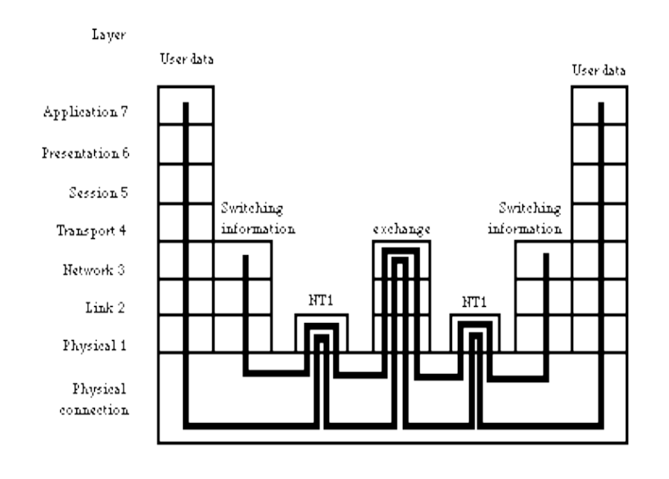
ISDN Basics
Architecture:
For straightforward data purposes, ISDN only defines layer 1 attributes for the “B” channel
“D” channel signalling is defined for layers 1 through 3
CP2073 - Networking

Slide 64
ISDN Basics
Types of services:
BRI is 2 64Kbps “B” channels and 1 16Kbps “D” channel in North America and Europe
PRI is 23 64Kbps “B” channels and 1 64Kbps “D” channel in North America
PRI is 30 64Kbps “B” channels and 1 64Kbps “D” channel in Europe
“B” channels may be grouped in both services to provide for increased bandwidth
CP2073 - Networking

Slide 65
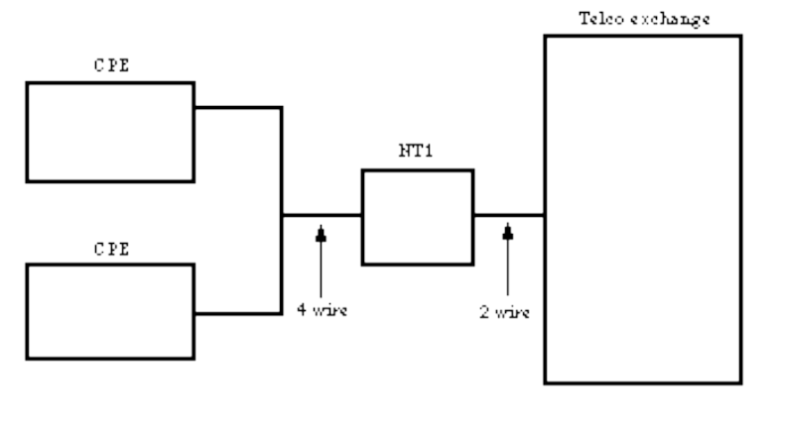
ISDN Basics
ISDN wiring for BRI:
NT1 is the Network Termination and is on the customer premisis.
In the US, this is customer owned.
In Europe, it is not customer owned.
2 wires from the exchange to the NT1
4 wires from the NT1 to the CPE. RJ-45 connectors are used
S/T
interface
U
interface
CP2073 - Networking

